Slide 1


SENTIMENT ANALYSIS
Analysing Text Data using
Natural Language Processing
Nikhil kumar BSc | Praneeth BSc

Slide 2
Introduction

Slide 3
Problem Statement
Understanding Customer Needs and Opinions
Objective
Perform Sentiment Analysis on Amazon Review Data and Build Effective Model

Slide 4
Project Lifecycle
Understanding Data
Data preparation
EDA
Model Building
Model Prediction
Model Evaluation

Slide 5
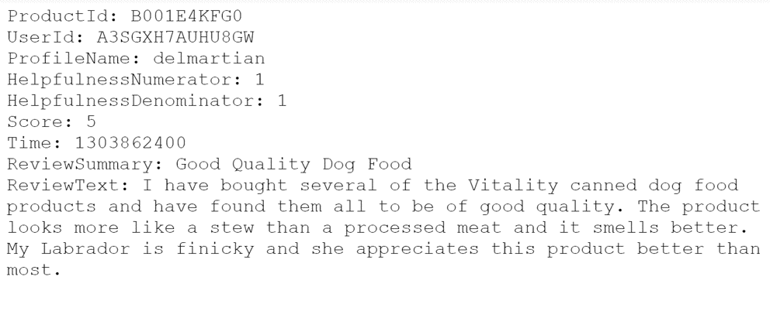
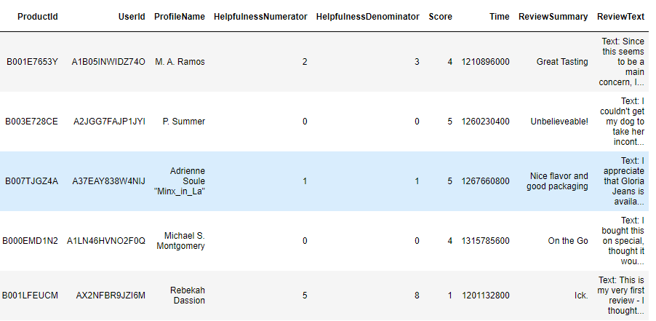
Data
Extraction of 5,68,454 text files from Zipped folder Data observations | Creation of DataFrame Transformation of Data to tabular format (.csv)
BEFORE
AFTER

Slide 6
Understanding Data
Number of reviews: 5,68,454
Number of users: 2,56,059
Number of products: 74,258
Timespan: Oct 1999 — Oct 2012
Number of Features (columns) in data: 9
Features
ProductId
UserId
ProfileName
Helpfulness Numerator
HelpfullnessDenominator
Score
Time
Summary
ReviewText

Slide 7
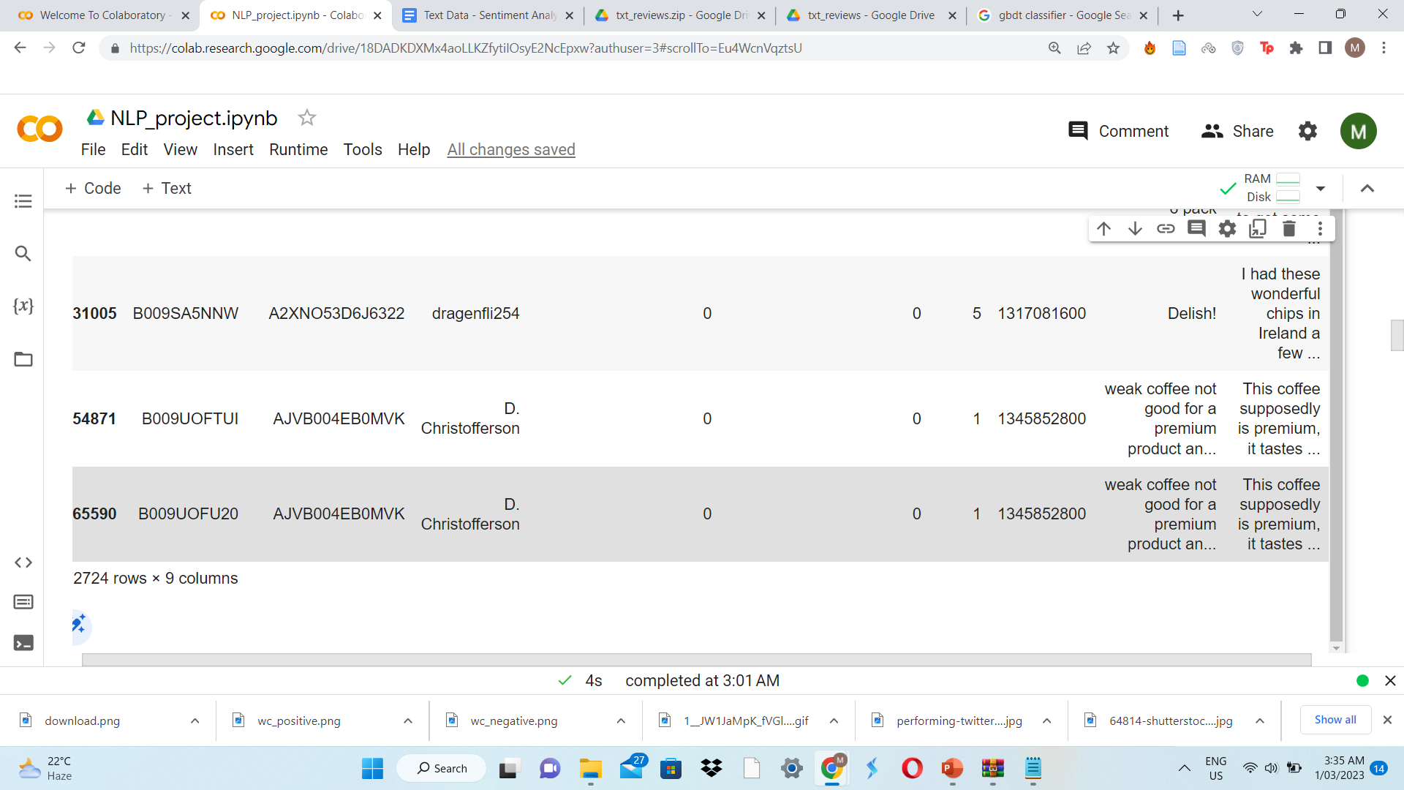
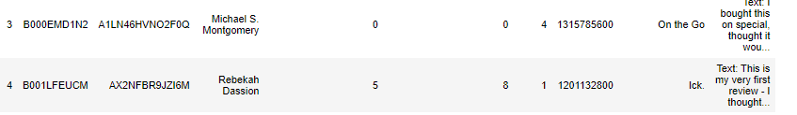
Data Cleaning
Import required libraries
Load the Data (.csv)
Duplicates
Sort
Drop
Missing values
Corrupted Data
Type conversion
(int to datetime)
Drop values where HelpfulnessNumerator > HelpfulnessDenominator

Slide 8



Review Classification
7.54%
Positive | Neutral | Negative
Score > 3 | Score = 3 | Score < 3
3,08,226 | 29,869 | 57,633

Slide 9
Data Preparation
Identification of Target variable
Segregation of inputs and output
Test-Train Split
Text Pre-processing – Lemmatization
1
2
3
4

Slide 10
Target Variable : Score
Input: ReviewText
Text Pre-Processing
PREREQUISITES Import nltk Download stopwords, wordnet, omw-1.4 Import re Import word_tokenize, stopwords, WordNetLemmatizer | PROCESS Special characters and digits removal Conversion to lowercase Tokenization into words Stop words removal Root words removal – Lemmatization

Slide 11
WordCloud
Positively Reviewed Data
Negatively Reviewed Data

Slide 12
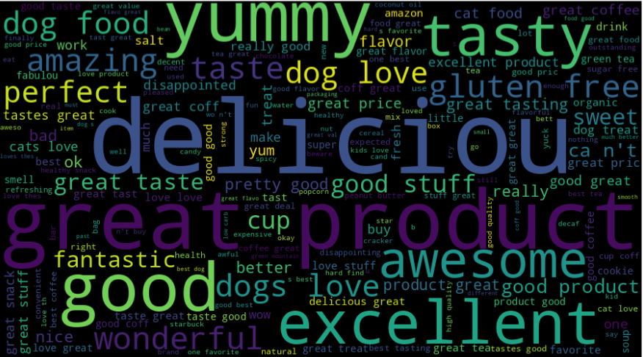
Positive Review Text

Slide 13
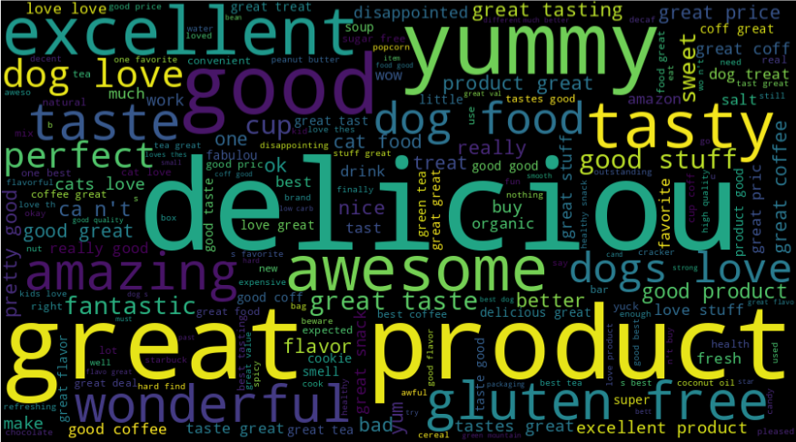
Negative Review Text

Slide 14
Conversion of Text to Numerical vectors – Bag Of Words Representation
Import sklearn
Import CountVectorizer
Creation of object for CountVectorizer
Applying fit_transform on X_train Data
Applying transform on X_test Data
Number of unique words found = 61,866

Slide 15
Evaluation
Logistic Regression
K-Nearest Neighbors Classifier
Decision Tree Classifier
Random Forest Classifier
Gradient Boosting Classifier
ADA Boost Classifier

Slide 16
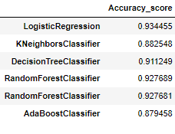
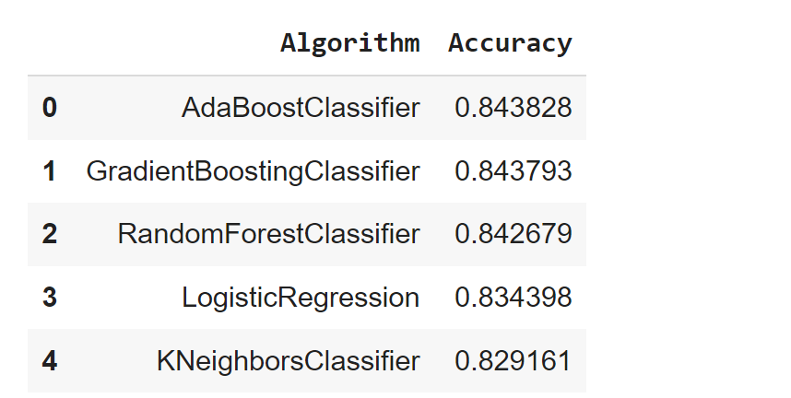
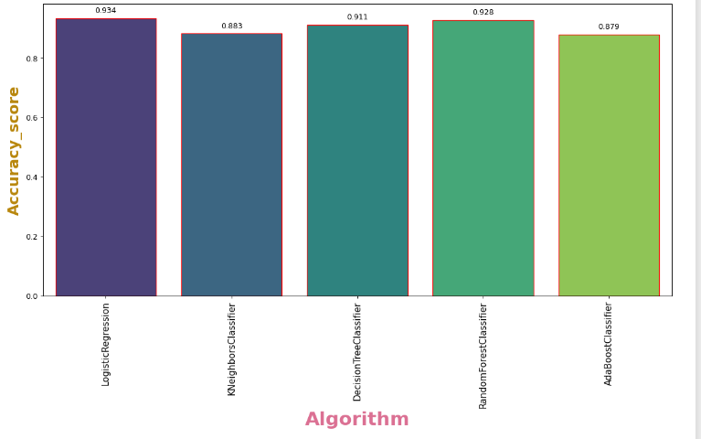
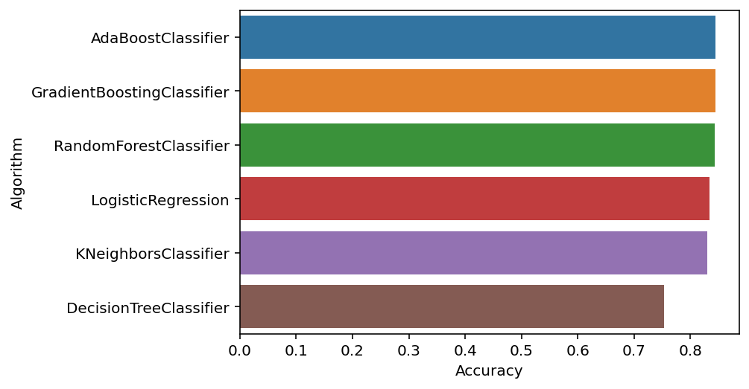

Slide 17


Slide 18

THANK YOU
For your patience & Time

